Slide 1
Who we are: Comagine Health is a national, nonprofit health care consulting firm. We work collaboratively with patients, providers, payers and other stakeholders to reimagine, redesign and implement sustainable improvements in the health care system.

Slide 2
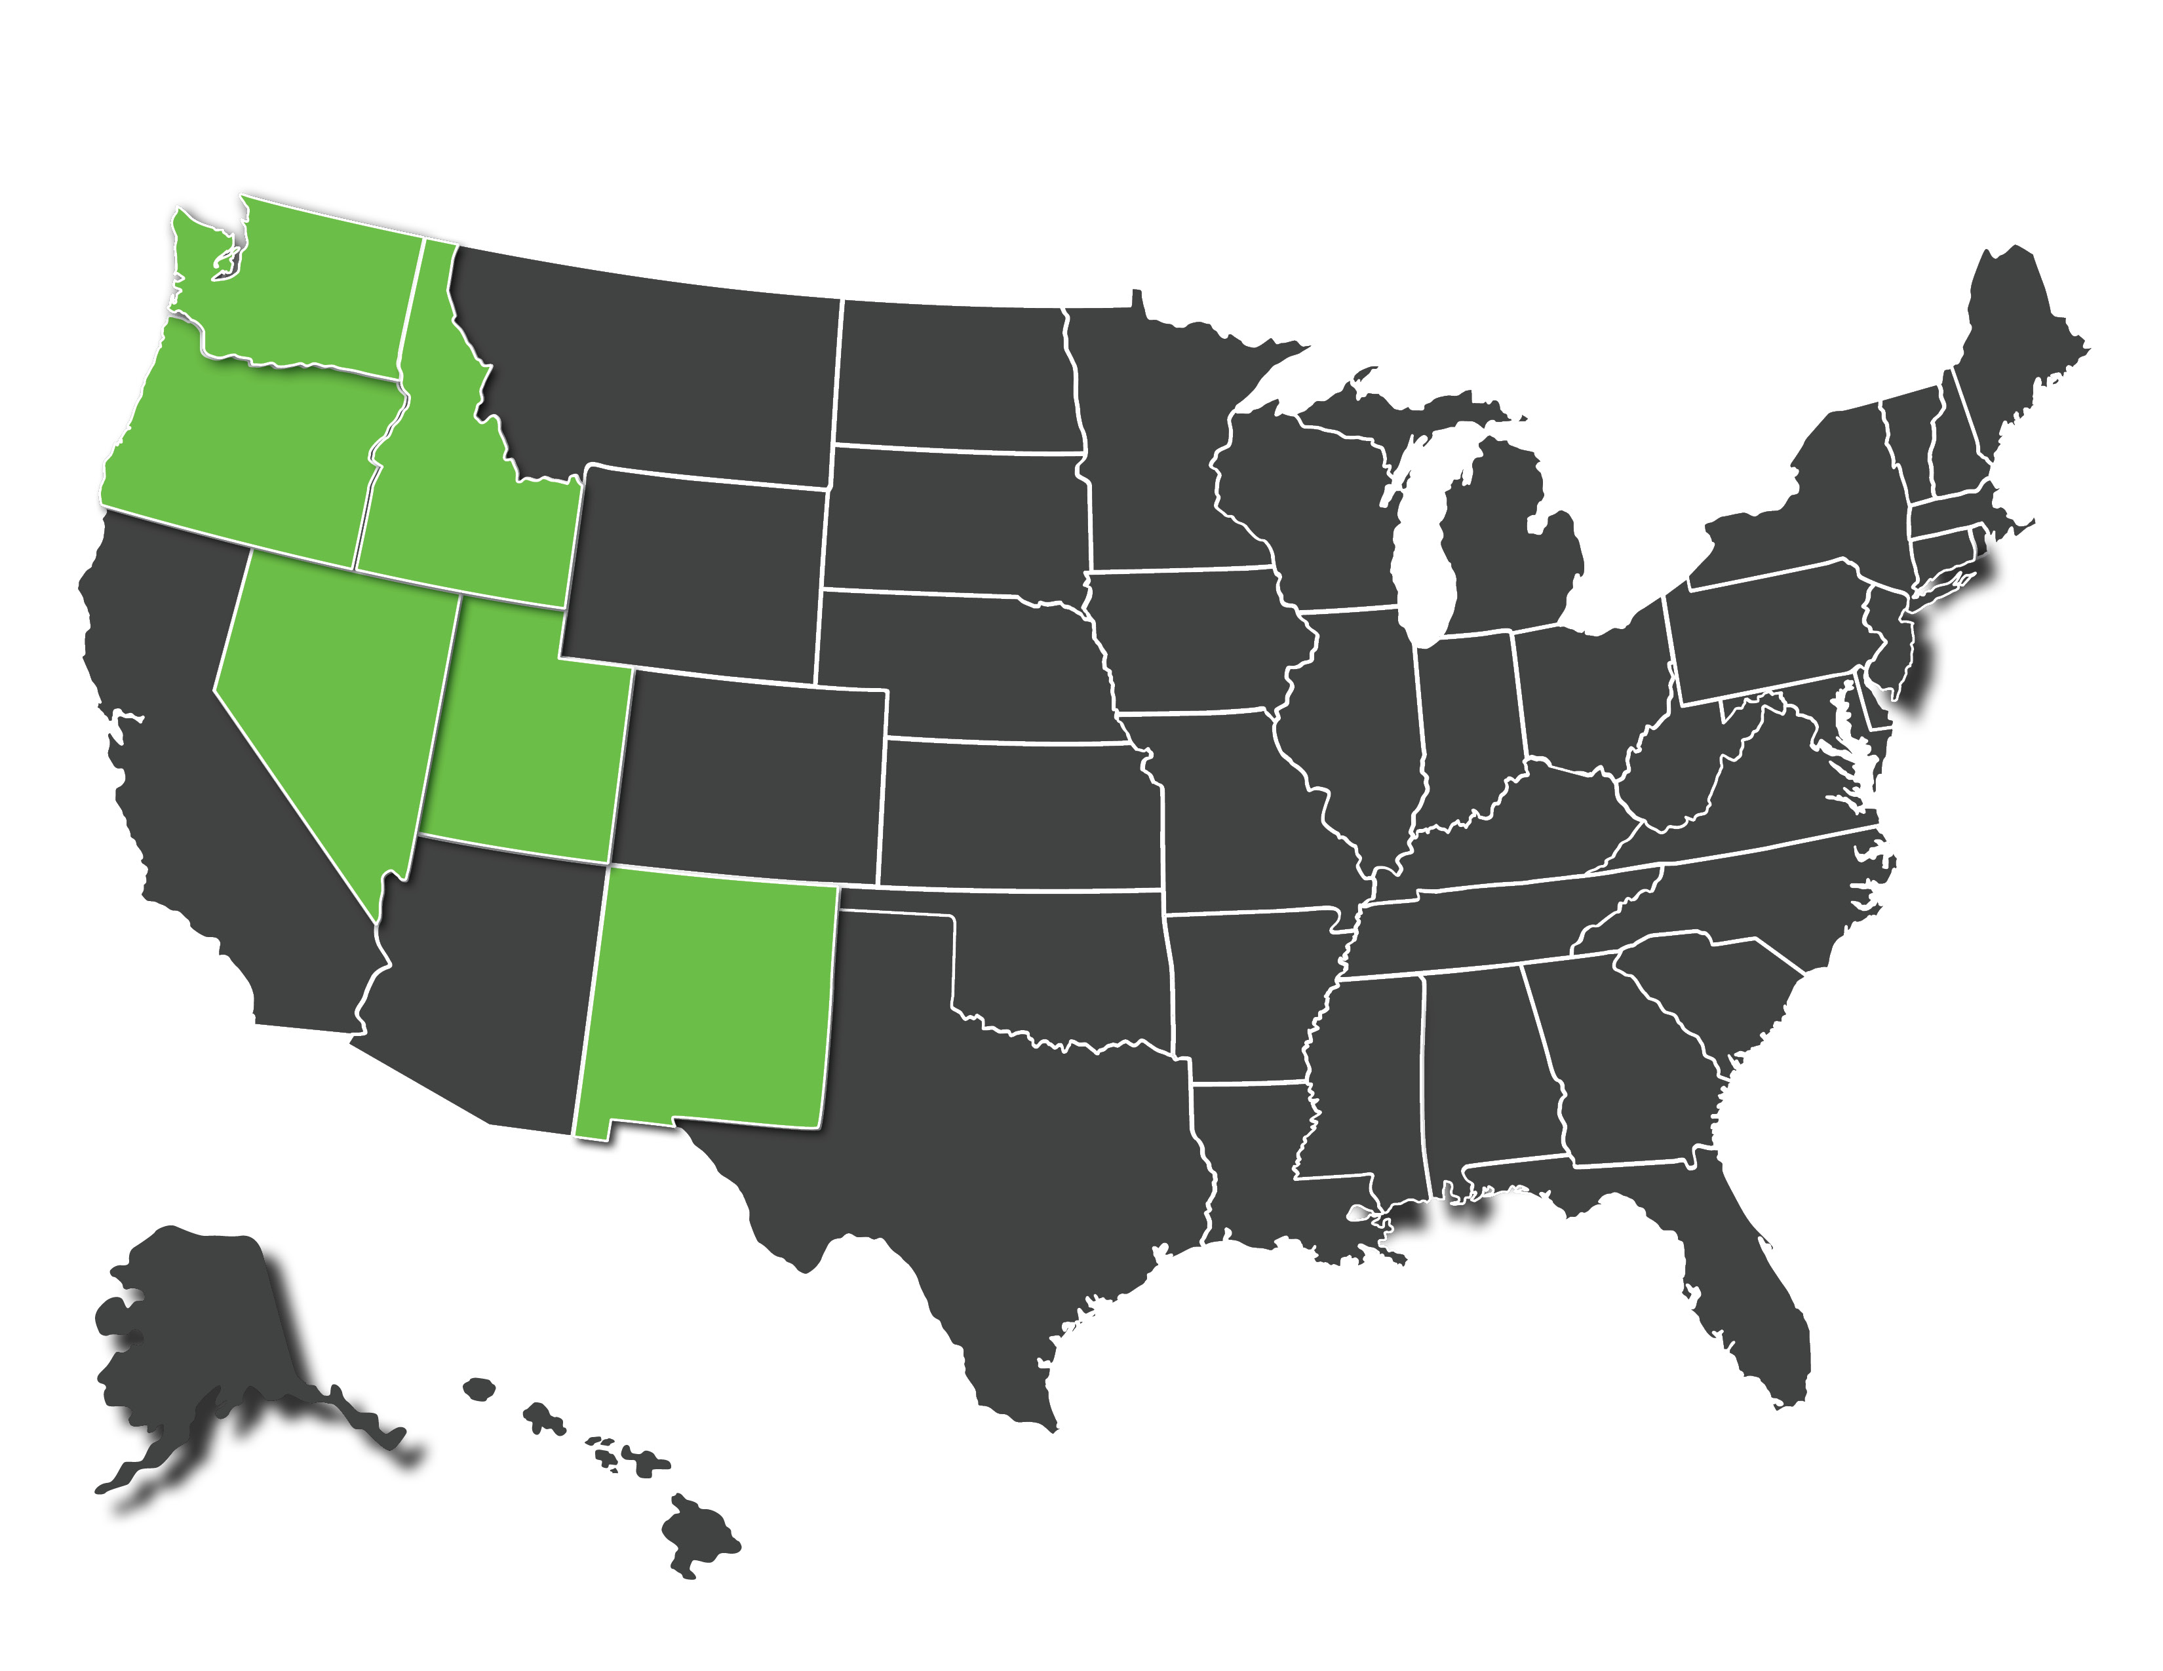
Our Work as the QIN-QIO
Comagine Health is the Medicare Quality Innovation Network-Quality Improvement Organization (QIN-QIO) for Idaho, New Mexico, Nevada, Oregon, Utah and Washington.
We receive federal funding from the Centers for Medicare and Medicaid Services (CMS) to carry out health care quality improvement activities.
We’re partnering with health care providers in our six states to improve patient outcomes and care processes through innovation, quality improvement initiatives and data-driven approaches.

Slide 3
We Provide:
Expert consultation, useful resources and training, and opportunities to collaborate with your peers.
Data and analytic reports about your organization and communities’ performance on key health care quality measures.
Tools to help align your priorities and solve your most complex challenges.
Coaching from Comagine Health staff with expertise in quality improvement.
Services are at no cost to you, paid for by CMS.

Slide 4
Our Current Work – Cardiac Rehabilitation
We are looking at the increasing the number of people who have experienced a cardiac event and have not yet gone to cardiac rehabilitation
We want to help CR facilities increase referrals & enrollment to cardiac rehabilitation programs
We encourage and invite partners and communities to work with us to improve the health care delivery system, especially as it relates to CR

Slide 5
Cardiac Rehab: Saving Lives, Restoring Health, Preventing Disease
Individuals who attend 36 sessions have a 47% lower risk of death
31% of individuals lower their risk of heart attack after only 1 session
Costs per year of life saved range from $4,950 to $9,200 per person
Cardiac rehab participation reduces hospital readmissions
Benefits | Referral | Participation
36 sessions of Supervised exercise Patient counseling Nutritional and lifestyle education | Many people who can benefit are not referred – women, minorities, people who live in rural areas. Many people who are referred do not enroll. | Of those who are enrolled, reaching the threshold of 36 sessions presents many barriers.
We Know how to eliminate barriers.

Slide 6
Contact Us:
Perrin Anderl panderl@comagine.org Karen Vest-Taubert kvest-taubert@comagine.org
This material was prepared by Comagine Health, a Medicare Quality Innovation Network-Quality Improvement Organization under contract with the Centers for Medicare & Medicaid Services (CMS), an agency of the U.S. Department of Health and Human Services. Views expressed in this material do not necessarily reflect the official views or policy of CMS or HHS, and any reference to a specific product or entity herein does not constitute endorsement of that product or entity by CMS or HHS. 12SOW-GEN-22-QIN-130

